Slide 1
Choosing the right automotive component coding solution
Linx Printing Technologies Ltd.

Slide 2
Overview
The automotive industry
The importance of traceability
The risk of counterfeiting
Choosing the right coding solution – factors to consider
Coding technologies

Slide 3
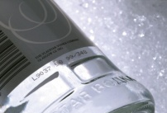
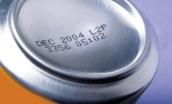
The automotive industry
The automotive industry is huge with Europe’s car parts sector employing about five million people, 82,000 of which are employed in the UK
As many as 1.5 million vehicles and 2.5 million engines are produced in the UK each year, and the UK government has identified a $3bn opportunity for domestic suppliers to provide parts to UK-based vehicle manufacturers
Industry operating profit margins are predicted to grow, widening to an estimated 8.1% in 2017-18. This is due to better stock controls, more efficient supply chain systems and more stable demand than over the past 5 years
Sources –
Ft.com, Jan 2013 http://www.ft.com/cms/s/0/9251485a-6873-11e2-ad8f-00144feab49a.html#axzz31amP2vpN
Society of Motor Manufacturers and Traders http://www.smmt.co.uk/industry-topics/uk-automotive-sector/
IBISworld http://www.ibisworld.co.uk/market-research/motor-vehicle-parts-wholesaling.html

Slide 4
Traceability
The Problem:
Guaranteeing the traceability of every component that you code
Need to reassure your customers that you have robust coding for internal traceability; and also robust coding for their needs. Ensure traceability of components right through from production to end use
The Solution:
With high contrast pigmented inks, you can achieve better clarity coding in the industry for durable traceability right the way through to end use
The ability to print with permanence, and in a range of colours as well as a variety of styles, ensures you can create robust, legible and traceable coding on any substrate

Slide 5
Counterfeiting
The Problem:
Counterfeit auto parts including counterfeit brake pads, tyres, suspension components, steering linkages etc. are universally distributed and are being sold to consumers in growing numbers
Sub-standard parts put road users at great risk and it is thought that $12bn* of global counterfeiting is related to the automotive industry
The Solution:
Using scannable barcodes and anti-counterfeiting printing inks to mark surfaces, helps to make auto parts more traceable and prove a product is authentic
Smartphone technology, which involves texting a unique code that has been printed on a product to the end consumers, can confirm at point of sale that a product is genuine
* Construction Week - http://www.constructionweekonline.com/article-24837-gm-discusses-counterfeit-parts-in-the-middle-east/

Slide 6
Choosing the right coding solution - Factors to consider
As with any coding solution, there are the considerations of code
content, substrates and also line speed. Suppliers to the automotive
industry also need to consider:
Factory environment – in a hot and dusty coding environment, ensure your coder has the right IP rating and features to perform reliably, while delivering codes that stay put throughout the production process
Robust coding on products exposed to harsh conditions and chemicals during end use, such as brake fluids during end use
Withstanding washdowns of production equipment, and treatment of coded parts during the production process. Coders need to operate reliably, and codes need to stay in place.

Slide 7
Automotive industry – Coding technologies
Continuous Ink Jet
Cost-effective solution
Non-contact – ability to print on any substrate
Range of inks available ensures legibility on any colour substrate
Compact printhead adds versatility
Quicker to install and set up than laser coders
Large Character Marking
Well suited for printing onto secondary packaging e.g. cardboard boxes
Can be used on a variety of surfaces and materials
Can print high resolution quality
Easy to set up and adjust
Reliable and predictable cost of ownership

Slide 8
Automotive industry – Coding technologies
Laser
Non-contact coding
Permanent codes
Strong at delivering 2D codes
Low downtime – no consumables
High speed capability with no drying time
Highly versatile
Thermal Inkjet Printer
Primary and secondary coding
High resolution codes
High print quality
Cost effective solution for slower production lines

Slide 9
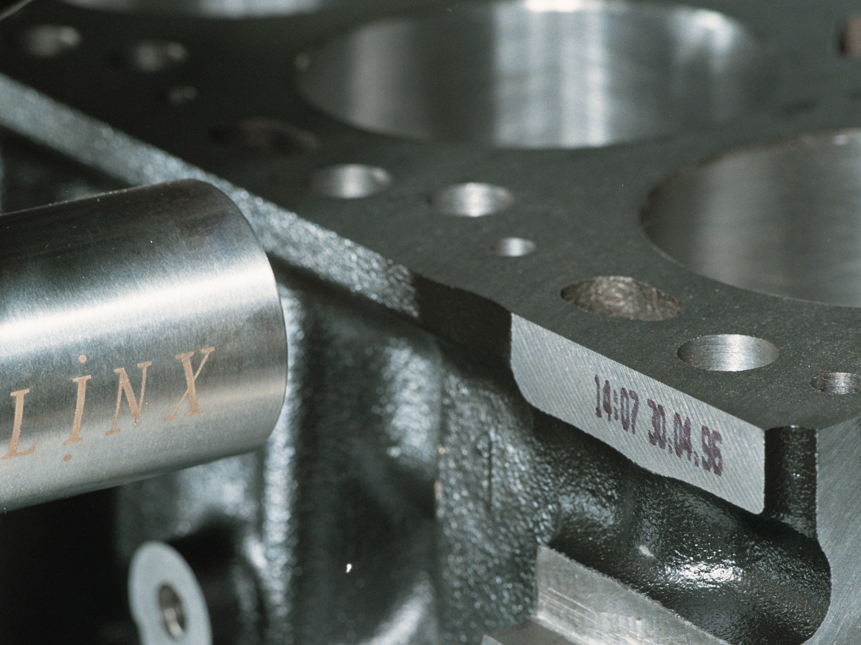
Find Out More
www.linx.co.uk/automotive

